Slide 1
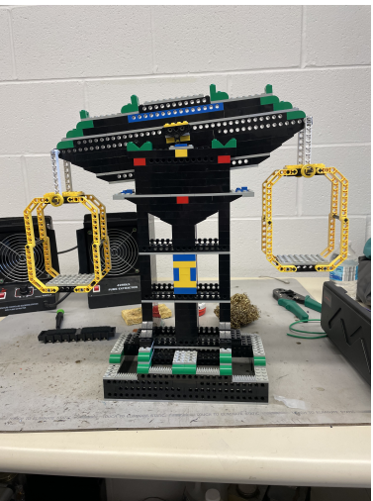
The Watt Balance: Control Systems, Optimization, and Pedagogy
ABE Graduate Watt Balance team:
Dr. Tony Grift
Beau Barber, Ali Fatemi, Toukir Ahmed, Daniela Pope

Slide 2
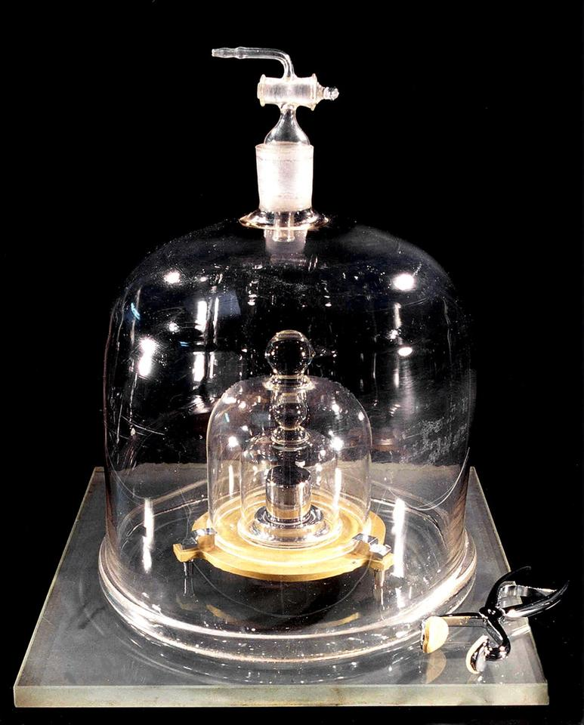
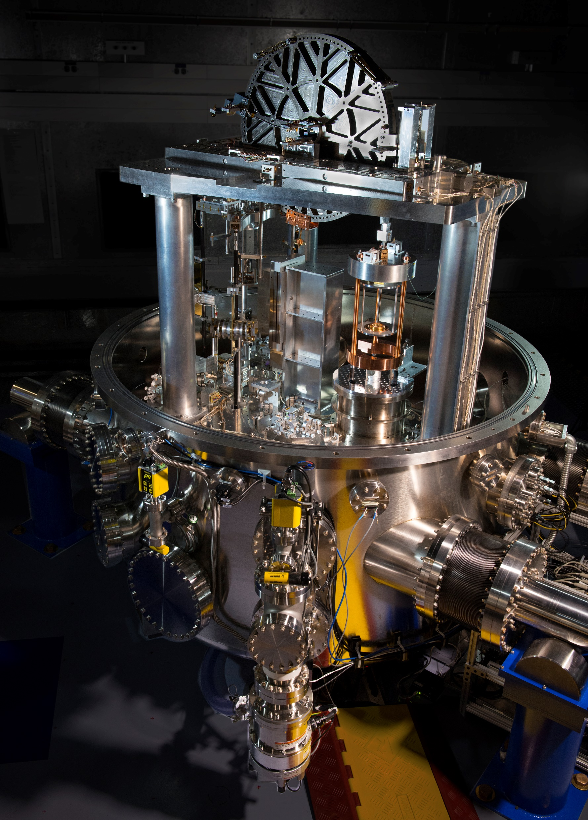
A briefer timeline of Kilogram definitions
IPK (nist.gov)
NIST-4 Watt Balance
1793
one liter water
at 4 degrees Celsius
1879
International Prototype
of the Kilogram
(IPK)
2019
Kibble balance
Notes:
"What do a kilogram and Planck's constant have in common? It's more than you might think. For decades, the International Prototype of the Kilogram (IPK), made of a platinum-iridium alloy, was the physical basis for this SI unit, until a more reliable, concrete, and unchanging method was proven as a standard of SI mass. As of 2018, the Kibble watt balance has been the instrument of choice for this task. The Watt Balance
is a mass metrology apparatus that balances the weight of an object against an electromagnetic force generated by a current-carrying coil immersed in a magnetic field. Two measurement modes are available, indirectly comparing electrical power and mechanical power in watts, linked through the use of Planck's constant.
Josephson effect and quantum Hall effect are what permit the measurement of electrical quantities in terms of the Planck constant required for precision and redefinition

Slide 3
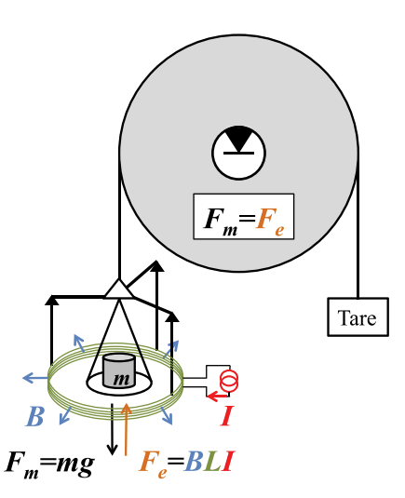
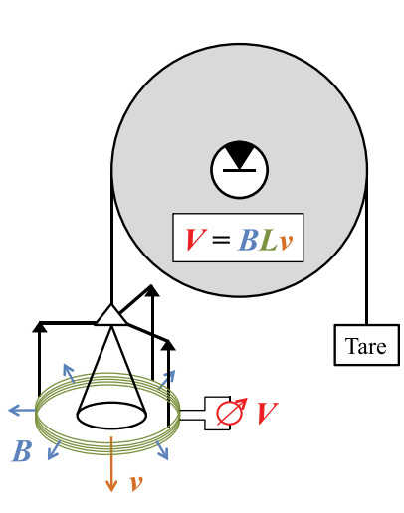
Force Mode
Velocity Mode
BL = BL
mg/I = V/$v$
$$m=\frac{VI}{gv}$$
BL=mg/I
BL=V/$v$
A LEGO Watt balance: An apparatus to determine a mass based on the new SI (nist.gov)
Notes:
"What do a kilogram and Planck's constant have in common? It's more than you might think. For decades, the International Prototype of the Kilogram (IPK), made of a platinum-iridium alloy, was the physical basis for this SI unit, until a more reliable, concrete, and unchanging method was proven as a standard of SI mass. As of 2018, the Kibble watt balance has been the instrument of choice for this task. The Watt Balance
is a mass metrology apparatus that balances the weight of an object against an electromagnetic force generated by a current-carrying coil immersed in a magnetic field. Two measurement modes are available, indirectly comparing electrical power and mechanical power in watts, linked through the use of Planck's constant.
Josephson effect and quantum Hall effect are what permit the measurement of electrical quantities in terms of the Planck constant required for precision and redefinition

Slide 4
Notes:
This measurement system is the realization of centuries of scientific progress and research carried out by some of the greatest scientists known in human history.
The Josephson effect and Quantum Hall effect (with the VonKlitzing constant) are what permit the measurement of electrical quantities in terms of the Planck constant required for precision and redefinition of the Kilogram, to further improve the metric system that began with Mocahin and Delambre. Ohm, Coulomb, and Isaac Newton are provided the basis of understanding for these electrical and mechanical forces. Faraday and Maxwell provided foundational work in electromagnetism such that this relation between electrical and mechanical forces can be realized. Michaelson and Morley produced the laser interferometer with which precise measurements can be made. All of these scientists work realized in the Kibble-Watt Balance that was first conceptualized by Bryan Kibble, which was posthumously named after him in his honor.

Slide 5
Improved Watt Balance for an educational, exciting model of a complicated yet tangible system
ABE Graduate Watt Balance Team
ECE 445 Student Team
Notes:
While the National Institute of Standards and Technology (NIST) provides free documentation to all who endeavor to create a Watt Balance of their own, there are certainly opportunities where ECE students in this class can improve upon their design and implementation. Following guidance from a graduate student team in ABE, a team of students will endeavor to improve upon the control system in a streamlined manner while optimizing space within the balance using the most appropriate sensors (there are many!). PCBs, Arduino, Raspberry PI... it's up to the team to decide which basis will lend itself to user-friendly programming as an educational tool."

Slide 6
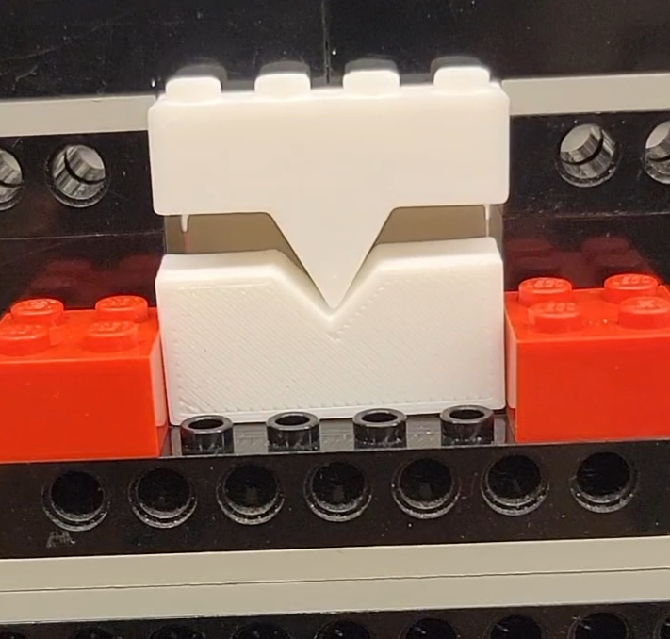
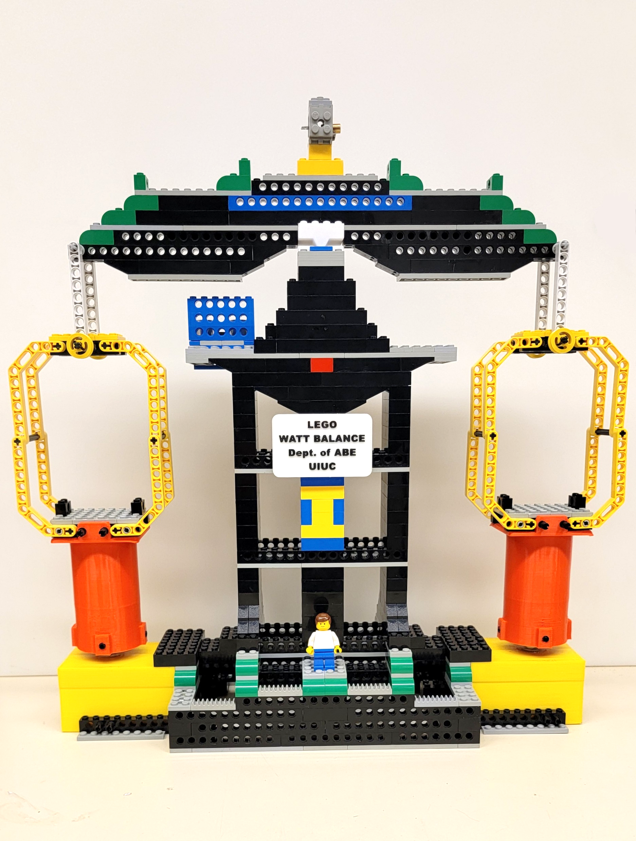
Current Setup
Fulcrum
Ultrasonic sensor
Laser pointer
Coils and magnets
within plastic casings
Mass panels
Notes:
While the National Institute of Standards and Technology (NIST) provides free documentation to all who endeavor to create a Watt Balance of their own, there are certainly opportunities where ECE students in this class can improve upon their design and implementation. Following guidance from a graduate student team in ABE, a team of students will endeavor to improve upon the control system in a streamlined manner while optimizing space within the balance using the most appropriate sensors (there are many!). PCBs, Arduino, Raspberry PI... it's up to the team to decide which basis will lend itself to user-friendly programming as an educational tool."

Slide 7
ECE 445 Student Team Challenge
Control system including sensors
Work with cost, size, speed constraints
Science communication / pedagogy

